Slide 1

Budget Management

Slide 2
What is a budget?
A budget is a financial plan that takes into account estimated revenue and expenses over a certain period of time.
Re-evaluated periodically
Three types of budgets: balanced budget, surplus budget, or a deficit budget.

Slide 3
Purpose of a Budget
Control spending
A tool for decision making
Plan and monitor where your money is going
Improve financial situation
Save money for goals and dreams

Slide 4
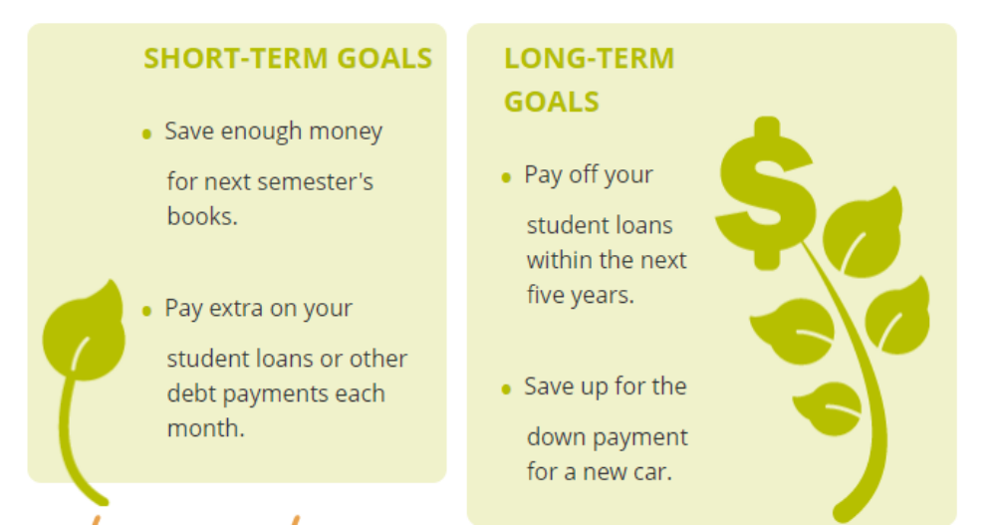
Set Goals

Slide 5
Basic Components to Budgeting
Income
Fixed expenses
Flexible expenses
Unplanned expenses

Slide 6
Income
When you are ready to start budgeting, start with finding your regular source of income
Examples:
“Take home money”
Money earned from working

Slide 7
Fixed Expenses
Any expense that does not change from period to period
Examples:
  Rent
  Utilities
  Loan payments
  Subscriptions
  Insurance

Slide 8
Flexible Expenses
An expense that can be cut back or eliminated
Examples:
Groceries
Dining out
Entertainment
Shopping – buying items you don’t necessarily need

Slide 9
Unplanned Expenses
Expenses that you did not see coming or that you did not plan for
Examples:
Car repair
Home repair
Medical emergency
Moving expenses
Job loss

Slide 10
Understanding the Numbers
How to understand the end result of the budget:
Surplus budget: income/revenues exceed expenses
Balanced budget: income/revenues are expected to equal expenses
Deficit budget: expenses will exceed income/revenues

Slide 11
Ted Talk
https://www.ted.com/talks/thasunda_duckett_6_ways_to_improve_your_relationship_with_money?language=en

Slide 12
Reflection

